Slide 1
Week 2 Presentation
11107014
林冠良

Slide 2
ADC
A system that converts an analog signal or physical voltage values into a digital signal.

Slide 3
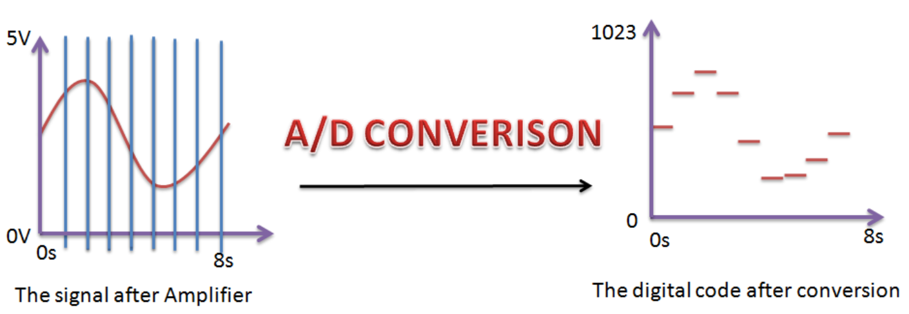
Analog Digital Converter
Sampling rate: how long does the signal gets converted
Resolution: how precise does the signal gets converted
Modes:
Single Conversion Mode
Continuous Conversion Mode
Scan Mode
Discontinuous Mode

Slide 4
UART
A hardware device for asynchronous serial communication in which the data format and transmission speeds are configurable.

Slide 5
Universal Asynchronous Receiver/Transmitter
Transmit data asynchronously.
Adds start and stop bits to the data packet being transferred.
Two UARTs communicate directly with each other.
Transmit process
Transmitting UART converts parallel data from a device into serial form.
Transmits it in serial to the receiving UART.
Then converts the serial data back into parallel data for the receiving device.

Slide 6
Packet
Start bit
Transmission line is normally high when it’s not transmitting data.
To start a transmission, transmitting UART pulls transmission line from high to low.
Data frame
5 bits to 8 bits, 9 bits if no parity bit is used.
Parity
Represent the evenness or oddness of the data.
Stop bits
The sending UART drives the data transmission line from a low voltage to a high voltage for at least two bit durations indicates the end of the data packet.

Slide 7
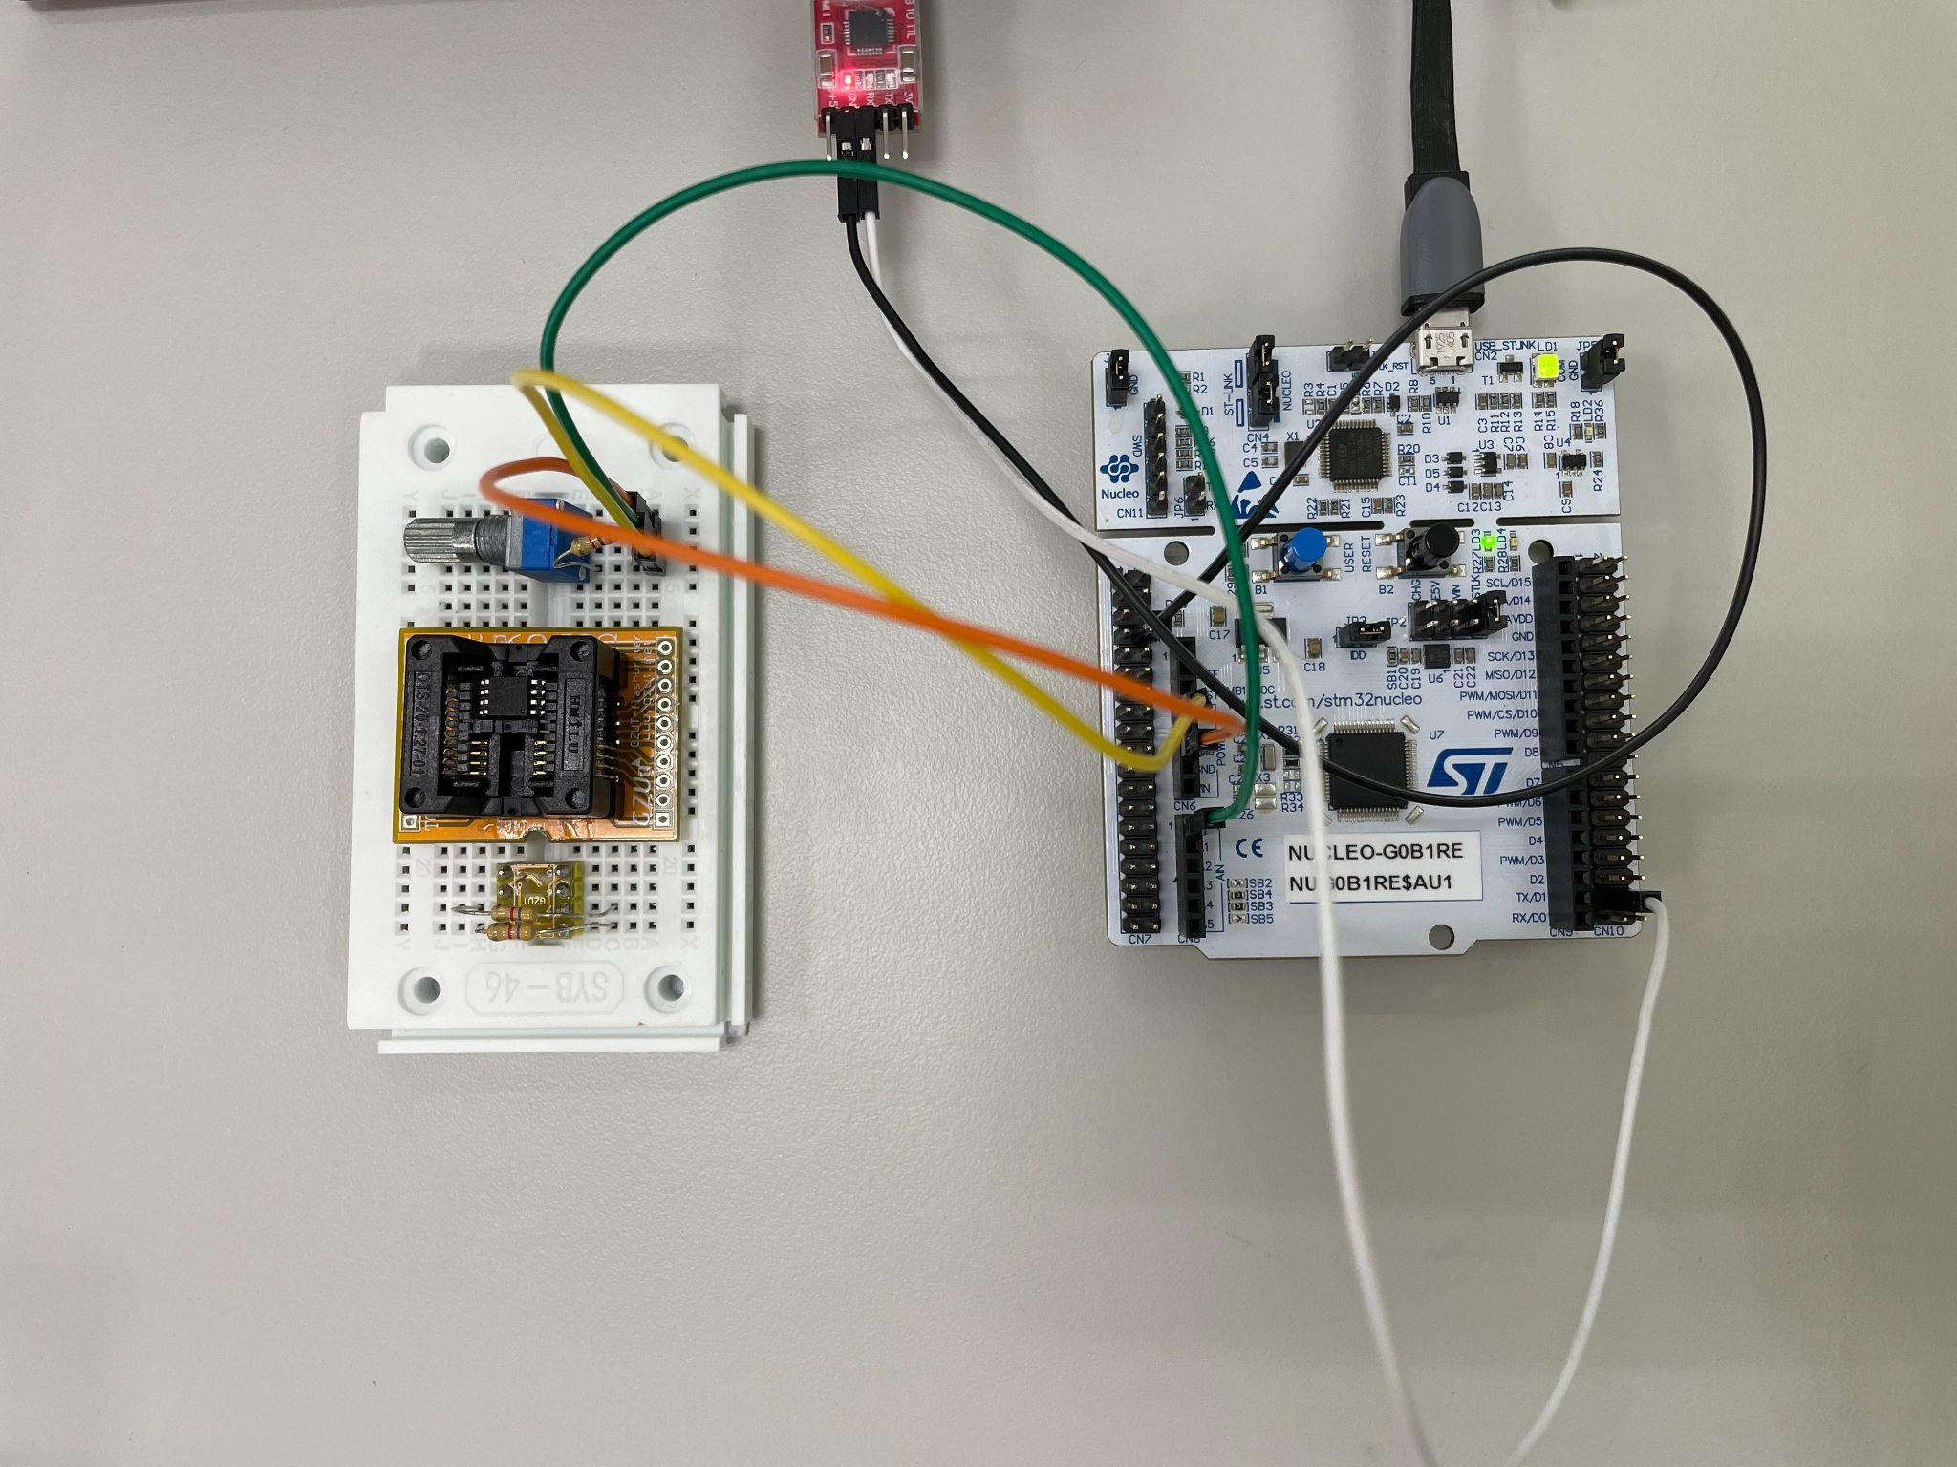
Circuit
Variable resistor(in series)
Orange: GND
Green: A0(ADC1)
Yellow: 3.3V
ST-Link
RX: TX pin on board(PC4)
GND: GND pin on board

Slide 8
Coding
ADC_to_UART

Slide 9
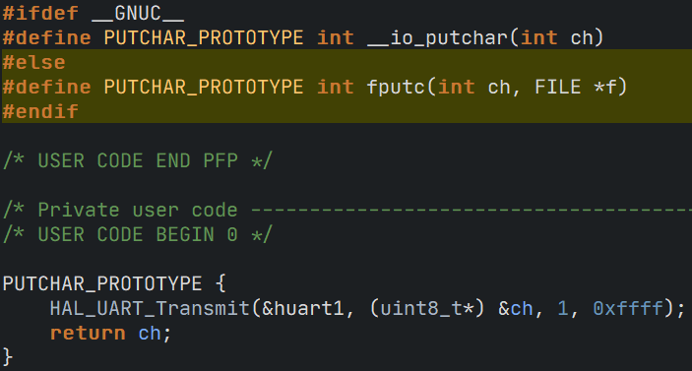
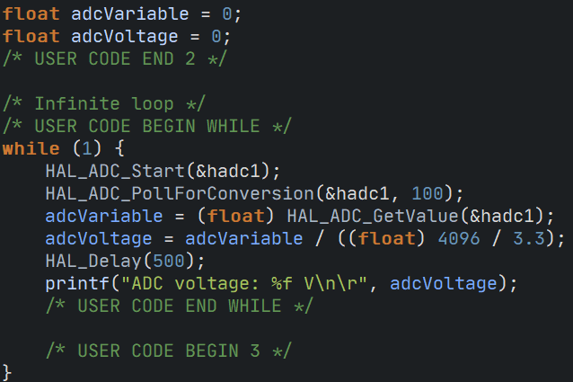
ADC_to_UART
Enable ADC1
Mode: IN0
Resolution: 12 bits
Enable USART1
Mode: Asynchronous
Baud rate: 115200 bits/s
Redefine PUTCHAR_PROTOTYPE for fputc() in printf()
Start ADC and Wait for conversion
Retrieve ADC read and calculate voltage value and transmit to UART using printf()

Slide 10
ADC_to_UART
Voltage conversion
actualVoltage = adcVariable / (adcResolution / systemVoltage)

Slide 11

Thank you for your listening
林冠良
Noah_Lin@wistron.com
https://github.com/popshia

